Slide 1

Dept. of Computer Science and Engineering
University of Rajshahi
www.ru.ac.bd
Dr. Shamim Ahmad

Slide 2
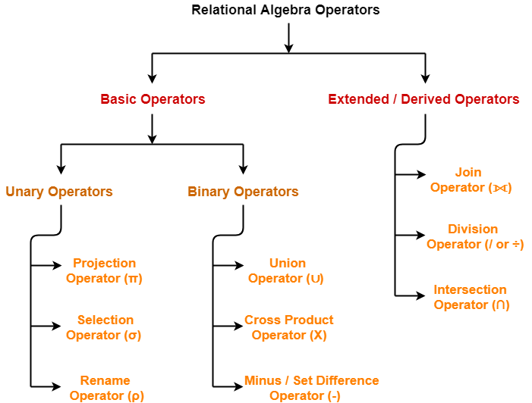

Slide 3
Select and Project Operation
SELECT (σ)
The SELECT operation is used for selecting a subset of the tuples (Horizontal subset ?) according to a given selection condition.
Select operator selects tuples that satisfy a given predicate
Projection(π)
The projection eliminates all attributes of the input relation but those mentioned in the projection list. The projection method defines a relation that contains values for a list all attributes (vertical subset ?) of Relation.
.
Source: https://www.guru99.com/relational-algebra-dbms.html#2

Slide 4
Roll | Name | Department | Fees | Team
1 | Bikash | CSE | 22000 | A
2 | Josh | CSE | 34000 | A
3 | Kevin | ECE | 36000 | C
4 | Ben | ECE | 56000 | D
Select all the student of Team A :
σ _{Team = 'A'} (Student)
Roll | Name | Department | Fees | Team
1 | Bikash | CSE | 22000 | A
2 | Josh | CSE | 34000 | A

Slide 5
Roll | Name | Department | Fees | Team
1 | Bikash | CSE | 22000 | A
2 | Josh | CSE | 34000 | A
3 | Kevin | ECE | 36000 | C
4 | Ben | ECE | 56000 | D
Select all the students of department ECE whose fees is greater then equal to 10000 and belongs to Team other than A.
σ _{Fees >= 10000}(σ_{Class != 'A'} (Student))

Slide 6
Roll | Name | Department | Fees | Team
1 | Bikash | CSE | 22000 | A
2 | Josh | CSE | 34000 | A
3 | Kevin | ECE | 36000 | C
4 | Ben | ECE | 56000 | D
Select all the students of department ECE whose fees is greater then equal to 10000 and belongs to Team other than A.
σ _{Fees >= 10000}(σ_{Class != 'A'} (Student))
Roll | Name | Department | Fees | Team
3 | Kevin | ECE | 36000 | C
4 | Ben | ECE | 56000 | D

Slide 7
CustomerID | CustomerName | Status
1 | Google | Active
2 | Amazon | Active
3 | Apple | Inactive
4 | Alibaba | Active
Π _{CustomerName, Status} (Customers)
CustomerName | Status
Google | Active
Amazon | Active
Apple | Inactive
Alibaba | Active
Source: https://www.geeksforgeeks.org/

Slide 8
Roll | Name | Department | Fees | Team
1 | Bikash | CSE | 22000 | A
2 | Josh | CSE | 34000 | A
3 | Kevin | ECE | 36000 | C
4 | Ben | ECE | 56000 | D
σ _{Fees >= 10000}(σ_{Class != 'A'} (Student))

Slide 9
Important points about Select operation :
Select operator is Unary, means it it applied to single relation only. Selection operation is commutative that is,
σ _{c1}(σ _{c2}(R)) = σ _{c2}(σ _{c1}(R))
The degree (number of attributes) of resulting relation from a Selection operation is same as the degree of the Relation given. The cardinality (number of tuples) of resulting relation from a Selection operation is,
0 <= σ _{c} (R) <= |R|

Slide 10
Class | Dept | Position
1st | CSE | Dr. Asif
1st | CSE | Dr. Kushal
2nd | CSE | Dr. Qawsar
2nd | EEE | Dr. Qawsar
3rd | EEE | Dr. Sangeeta
3rd | EEE | Dr. Asif`
1st | ICE | Dr. Sangeeta
1st | ISE | Dr. Kushal
π_{Class, Dept}(Faculty) ?
π_{Class, position}(Faculty) ?
π_{Dept, position}(Faculty) ?

Slide 11
π_{Attribute List 1}(π_{Attribute List2}(R)) = π_{Attribute List 2} (π_{Attribute List1}(R))
?
π_{Attribute List 1}(π_{Attribute List2}(R)) != π_{Attribute List 2} (π_{Attribute List1}(R))

Slide 12
The Project operation is not commutative
π_{Attribute List 1}(π_{Attribute List2}(R)) != π_{Attribute List 2} (π_{Attribute List1}(R))

Slide 13
π_{Attribute List 1}(π_{Attribute List2}(R))
???

Slide 14
The following expression is valid only if Attribute List 1 is a subset of Attribute List 2.
π_{Attribute List 1}(π_{Attribute List2}(R))
Any Alternate way?

Slide 15
The following expression is valid only if Attribute List 1 is a subset of Attribute List 2.
π_{Attribute List 1}(π_{Attribute List2}(R))
Any Alternate way?
π_{Attribute List 1}(π_{Attribute List2}(R)) = π_{Attribute List 1} (R)

Slide 16

https://www.mysqltutorial.org/mysql-cross-join/

Slide 17
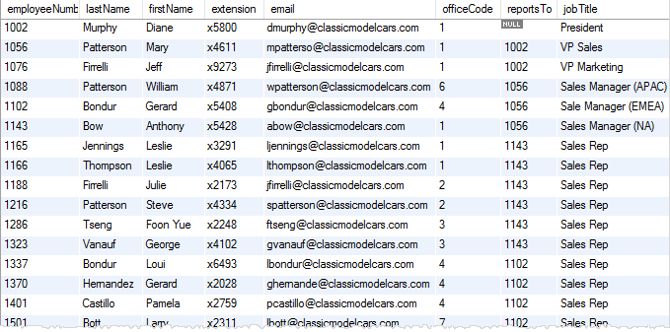
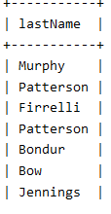

https://www.mysqltutorial.org/mysql-cross-join/

Slide 18
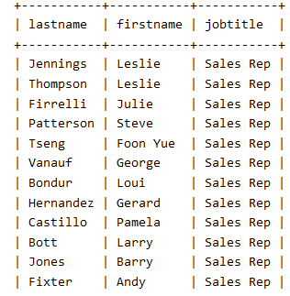
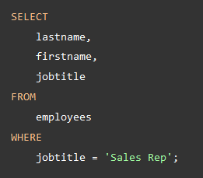
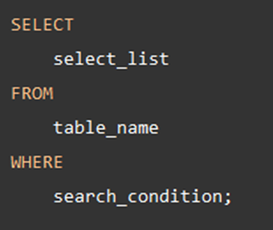
https://www.mysqltutorial.org/mysql-cross-join/

Slide 19

https://www.mysqltutorial.org/mysql-cross-join/

Slide 20
Roll | Name | Department | Fees | Team
1 | Bikash | CSE | 22000 | A
2 | Josh | CSE | 34000 | A
3 | Kevin | ECE | 36000 | C
4 | Ben | ECE | 56000 | D
Select all the student of Team A :
σ _{Team = 'A'} (Student)

Slide 21
CustomerID | CustomerName | Status
1 | Google | Active
2 | Amazon | Active
3 | Apple | Inactive
4 | Alibaba | Active
Π _{CustomerName, Status} (Customers)
Source: https://www.geeksforgeeks.org/

Slide 22
Cartesian-Product Operation
Notation r x s
Defined as:
r x s = {t q | t ∈ r and q ∈ s}
Assume that attributes of r(R) and s(S) are disjoint. (That is, R ∩ S = ∅).
If attributes of r(R) and s(S) are not disjoint, then renaming must be used.
If r1(R1) and r2(R2)
then r1 × r2 is a relation whose schema is the concatenation of R1 and R2.
Relation R contains all tuples t for which there is
a tuple t1 in r1 and
a tuple t2 in r2,
for which
t[R1] = t1[R1] and t[R2] = t2[R2].

Slide 23
Cartesian Product Operation in Relational Algebra
the CROSS PRODUCT of two relation
A(R1, R2, R3, …, Rp) with degree p,
B(S1, S2, S3, …, Sn) with degree n,
relation C(R1, R2, R3, …, Rp, S1, S2, S3, …, Sn) with degree p + n attributes

Slide 24
Cartesian-Product Operation – Example
Relations r, s:
A
B
C
D
E
α
β
1
2
α
β
β
γ
10
10
20
10
a
a
b
b
r
s
r x s:
A
B
C
D
E
If r(R) and s(S)
then r × s is a relation whose schema is the concatenation of R and S.
Relation Q contains all tuples t for which there is
a tuple t1 in r and
a tuple t2 in s,
for which
t[R] = t1[R] and t[S] = t2[S].
α
α
α
α
β
β
β
β
1
1
1
1
2
2
2
2
α
β
β
γ
α
β
β
γ
10
10
20
10
10
10
20
10
a
a
b
b
a
a
b
b

Slide 25
Composition of Operations
Can build expressions using multiple operations
Example: σ_{A=C}(r x s)
r x s
σ_{A=C}(r x s)
A
B
C
D
E
α
α
α
α
β
β
β
β
1
1
1
1
2
2
2
2
α
β
β
γ α
β
β
γ
10
10
20
10
10
10
20
10
a
a
b
b
a
a
b
b
A
B
C
D
E
α
β
β
α
β
β
10
10
20
a
a
b
α
β
β
1
2
2

Slide 26
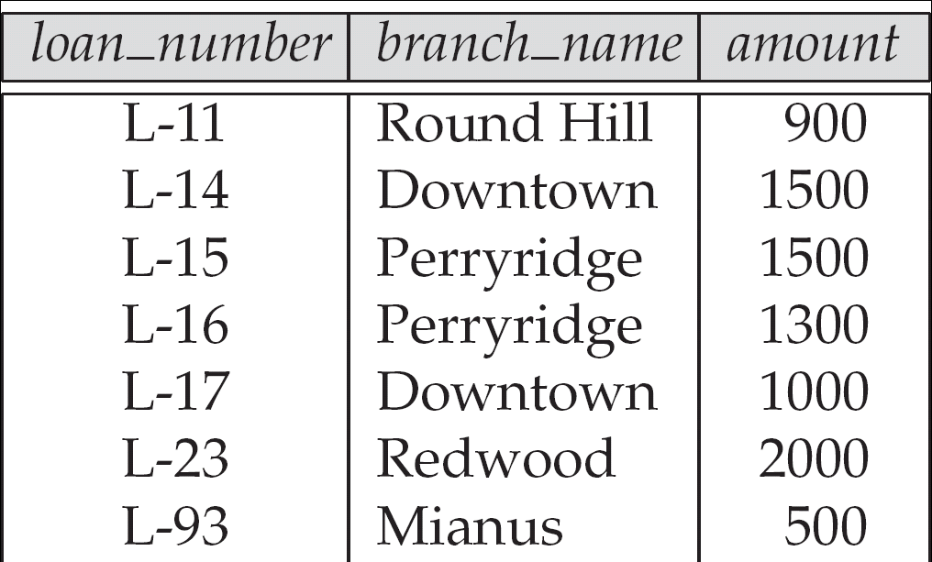
Example Queries
Find all loans of over $1200
The loan relation

Slide 27
Example Queries
Find all loans of over $1200
σ_{amount > 1200} (loan)
The loan relation

Slide 28
Example Queries
Find the loan number for each loan of an amount greater than $1200
The loan Relation

Slide 29
Example Queries
Find the loan number for each loan of an amount greater than $1200
∏_{loan_number} (σ_{amount} _{> 1200} (loan))
The loan Relation

Slide 30
Example Queries
The loan relation
σbranch-name =“Perryridge”∧ amount>1200 (loan)

Slide 31
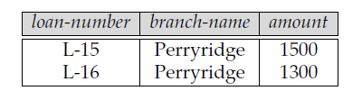
Example Queries
The loan relation
σbranch-name =“Perryridge”∧ amount>1200 (loan)

Slide 32
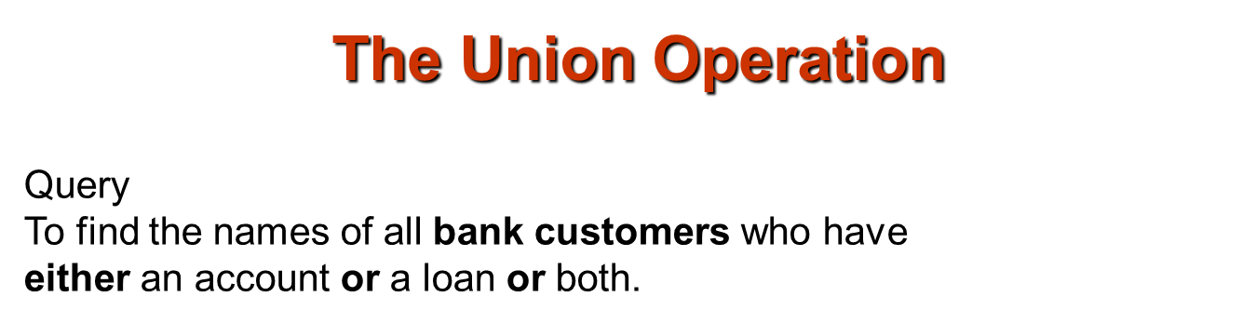
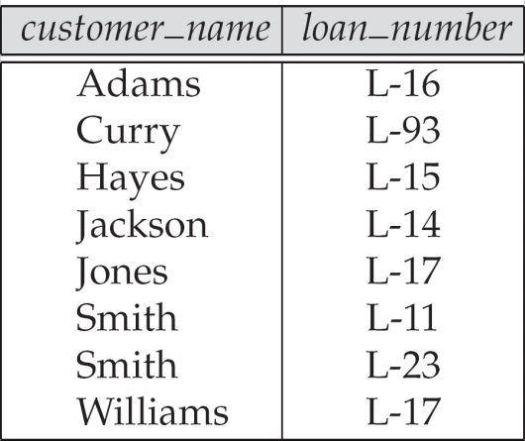
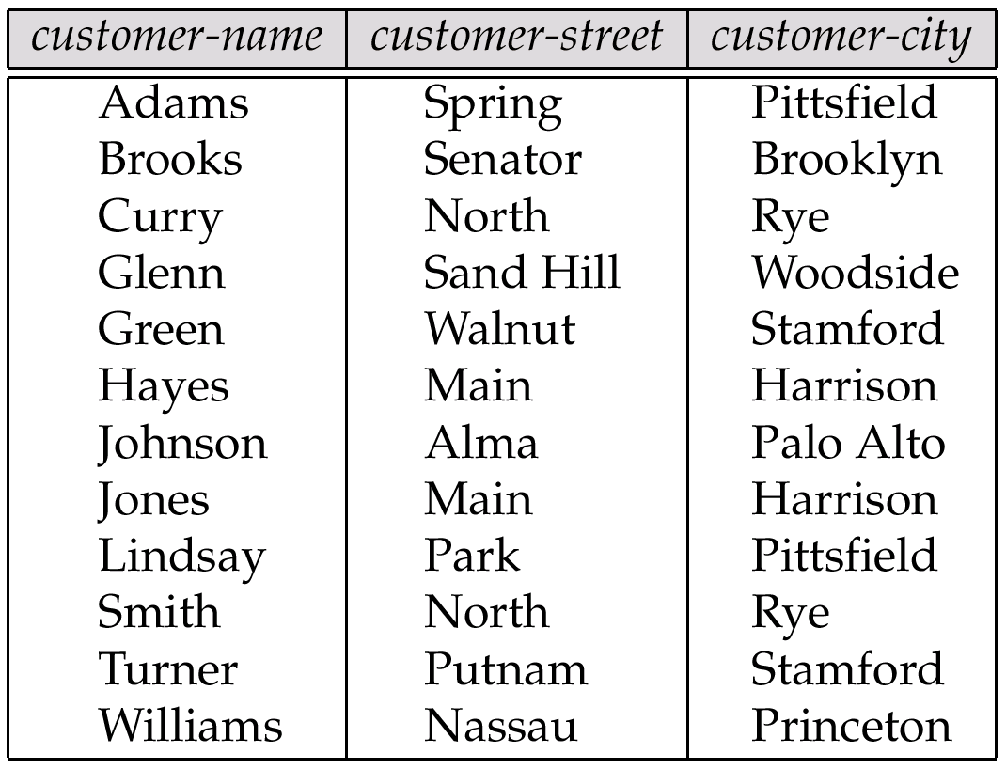
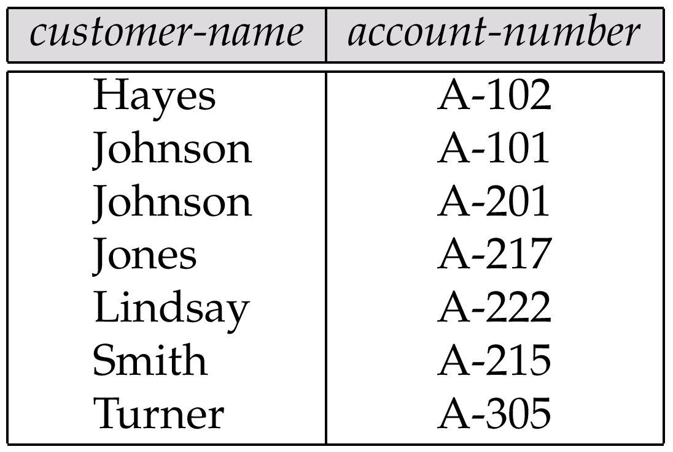
The borrower relation
The customer Relation
The depositor Relation

Slide 33
The borrower relation
The depositor Relation
The customer Relation
Πcustomer-name (borrower )
Πcustomer-name (depositor)

Slide 34
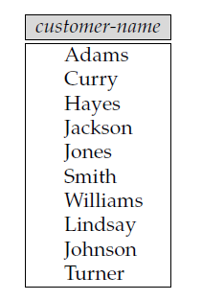

Example Queries
Find the names of all customers who have a loan, an account, or both, from the bank
∏_{customer_name} (borrower) ∪ ∏_{customer_name} (depositor)
The borrower relation
The depositor Relation

Slide 35
Set Difference Operation
Query
Find all customers of the bank who have
an account but not a loan
The borrower relation
The depositor Relation
The customer Relation

Slide 36
Set Difference Operation
Query
Find all customers of the bank who have
an account but not a loan
The borrower relation
The depositor Relation
The customer Relation
Πcustomer-name (borrower )
Πcustomer-name (depositor)

Slide 37
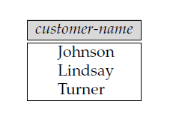
Set Difference Operation
Query
Find all customers of the bank who have
an account but not a loan
The expression r − s produces a relation
containing those tuples in r but not in s.
Πcustomer-name (depositor) − Πcustomer-name (borrower )
The borrower relation
The depositor Relation

Slide 38
Set Difference Operation
Query
Find all customers of the bank who have
an loan but not a account
The expression r − s produces a relation
containing those tuples in r but not in s.
The borrower relation
The depositor Relation

Slide 39
Set Difference Operation
Query
Find all customers of the bank who have
an loan but not a account
The expression r − s produces a relation
containing those tuples in r but not in s.
Πcustomer-name (borrower ) - Πcustomer-name (depositor)
The borrower relation
The depositor Relation

Slide 40
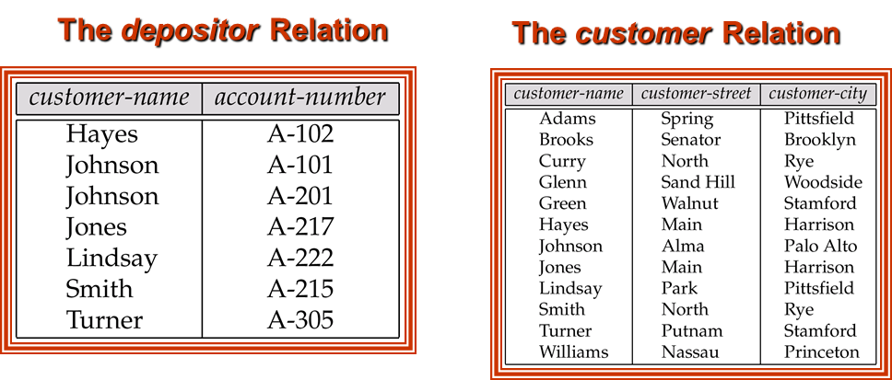
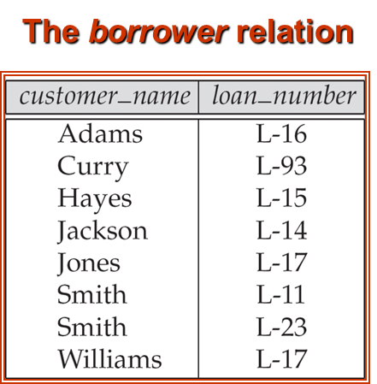

Example Queries
Find the names of all customers who have a loan at the Perryridge branch.
The loan relation

Slide 41
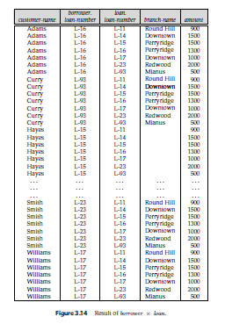
Example Queries
Find the names of all customers who have a loan at the Perryridge branch.
∏_{customer_name} (σ_{branch_name=“Perryridge”} (borrower x loan))
The loan relation

Slide 43
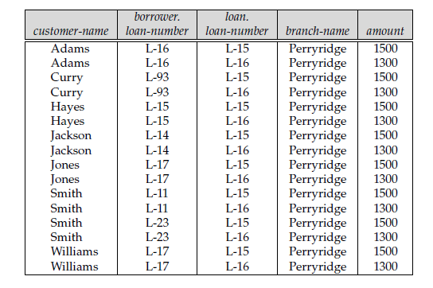
σbranch-name =“Perryridge”(borrower × loan)

Slide 44
Example Queries
Find the names of all customers who have a loan at the Perryridge branch.
σborrower .loan-number =loan.loan-number (σbranch-name =“Perryridge”(borrower × loan))
To have only customer-name, we do a projection
Πcustomer-name (σborrower .loan-number =loan.loan-number
(σbranch-name =“Perryridge” (borrower × loan)))

Slide 45
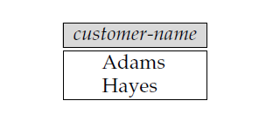
Result of
Πcustomer-name
(σborrower .loan-number =loan.loan-number
(σbranch-name =“Perryridge” (borrower × loan))).

Slide 46
Example Queries
Find the names of all customers who have a loan at the Perryridge branch.
Πcustomer-name (σborrower .loan-number =loan.loan-number
(σbranch-name =“Perryridge” (borrower × loan))).
OR ??
∏_{customer_name} (σ_{branch_name=“Perryridge”}
(σborrower.loan_number = loan.loan_number(borrower x loan)))

Slide 47
Rename Operation
Allows us to name, and therefore to refer to, the results of relational-algebra expressions.
Allows us to refer to a relation by more than one name.
Example:
ρ _{x} (E)
returns the expression E under the name X
If a relational-algebra expression E has arity n, then
returns the result of expression E under the name X, and with the
attributes renamed to A₁ , A₂ , …., A_{n} .

Slide 48
Example-1: Query to rename the relation Student as MaleStudent and the attributes of Student – RollNo, SName as (Eno, Name).
ρ _{MaleStudent(Eno, Name)} π_{RollNo, SName}(σ_{Condition}(Student))
Eno | Name
2600 | Ronny
2655 | Raja

Slide 49
Example: Query to rename the attributes Name, Age of table Department to A,B.
ρ _{(A, B)} (Department)
Example: Query to rename the table name Project to Pro and its attributes to P, Q, R.
ρ _{Pro(P, Q, R)} (Project)
Example: Query to rename the first attribute of the table Employee with attributes A, B, C to P.
ρ _{(P, B, C)} (Employee)

Slide 50
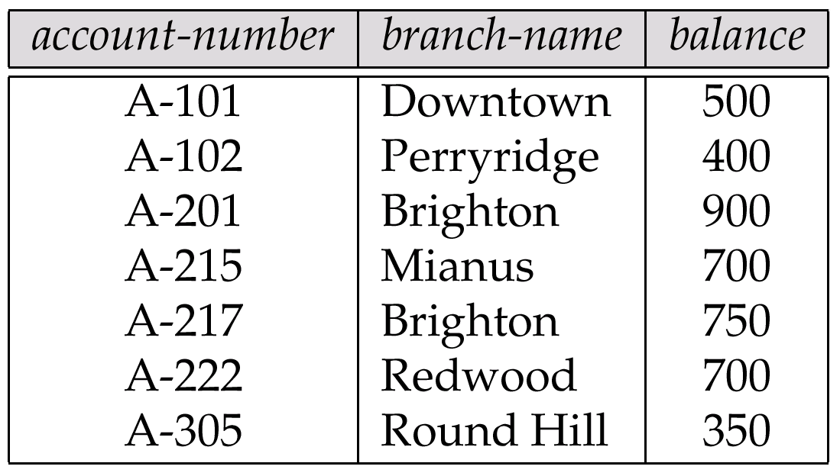
Query:
Find the largest account balance in the bank.
The account relation

Slide 51
Account_no | Brance_name | Balance
101 | Rajshahi | 700
104 | Bogra | 450
112 | Rajshahi | 900
130 | Khulna | 600
140 | Dhaka | 350

Slide 52
Account_no | Brance_name | Balance | Account_no | Brance_name | Balance
101 | Rajshahi | 700 | 101 | Rajshahi | 700
101 | Rajshahi | 700 | 104 | Bogra | 450
101 | Rajshahi | 700 | 112 | Rajshahi | 900
101 | Rajshahi | 700 | 130 | Khulna | 600
101 | Rajshahi | 700 | 140 | Dhaka | 350
104 | Bogra | 450 | 101 | Rajshahi | 700
104 | Bogra | 450 | 104 | Bogra | 450
104 | Bogra | 450 | 112 | Rajshahi | 900
104 | Bogra | 450 | 130 | Khulna | 600
104 | Bogra | 450 | 140 | Dhaka | 350
112 | Rajshahi | 900 | 101 | Rajshahi | 700
112 | Rajshahi | 900 | 104 | Bogra | 450
112 | Rajshahi | 900 | 112 | Rajshahi | 900
112 | Rajshahi | 900 | 130 | Khulna | 600
112 | Rajshahi | 900 | 140 | Dhaka | 350
130 | Khulna | 600 | 101 | Rajshahi | 700
130 | Khulna | 600 | 104 | Bogra | 450
130 | Khulna | 600 | 112 | Rajshahi | 900
130 | Khulna | 600 | 130 | Khulna | 600
130 | Khulna | 600 | 140 | Dhaka | 350
140 | Dhaka | 350 | 101 | Rajshahi | 700
140 | Dhaka | 350 | 104 | Bogra | 450
140 | Dhaka | 350 | 112 | Rajshahi | 900
140 | Dhaka | 350 | 130 | Khulna | 600
140 | Dhaka | 350 | 140 | Dhaka | 350

Slide 53
σt1 .balance < t2.balance
Account_no | Brance_name | Balance | Account_no | Brance_name | Balance
101 | Rajshahi | 700 | 101 | Rajshahi | 700
101 | Rajshahi | 700 | 104 | Bogra | 450
101 | Rajshahi | 700 | 112 | Rajshahi | 900
101 | Rajshahi | 700 | 130 | Khulna | 600
101 | Rajshahi | 700 | 140 | Dhaka | 350
104 | Bogra | 450 | 101 | Rajshahi | 700
104 | Bogra | 450 | 104 | Bogra | 450
104 | Bogra | 450 | 112 | Rajshahi | 900
104 | Bogra | 450 | 130 | Khulna | 600
104 | Bogra | 450 | 140 | Dhaka | 350
112 | Rajshahi | 900 | 101 | Rajshahi | 700
112 | Rajshahi | 900 | 104 | Bogra | 450
112 | Rajshahi | 900 | 112 | Rajshahi | 900
112 | Rajshahi | 900 | 130 | Khulna | 600
112 | Rajshahi | 900 | 140 | Dhaka | 350
130 | Khulna | 600 | 101 | Rajshahi | 700
130 | Khulna | 600 | 104 | Bogra | 450
130 | Khulna | 600 | 112 | Rajshahi | 900
130 | Khulna | 600 | 130 | Khulna | 600
130 | Khulna | 600 | 140 | Dhaka | 350
140 | Dhaka | 350 | 101 | Rajshahi | 700
140 | Dhaka | 350 | 104 | Bogra | 450
140 | Dhaka | 350 | 112 | Rajshahi | 900
140 | Dhaka | 350 | 130 | Khulna | 600
140 | Dhaka | 350 | 140 | Dhaka | 350

Slide 54
ΠT1.balance
ΠT2 .balance
Account_no | Brance_name | Balance | Account_no | Brance_name | Balance
101 | Rajshahi | 700 | 101 | Rajshahi | 700
101 | Rajshahi | 700 | 104 | Bogra | 450
101 | Rajshahi | 700 | 112 | Rajshahi | 900
101 | Rajshahi | 700 | 130 | Khulna | 600
101 | Rajshahi | 700 | 140 | Dhaka | 350
104 | Bogra | 450 | 101 | Rajshahi | 700
104 | Bogra | 450 | 104 | Bogra | 450
104 | Bogra | 450 | 112 | Rajshahi | 900
104 | Bogra | 450 | 130 | Khulna | 600
104 | Bogra | 450 | 140 | Dhaka | 350
112 | Rajshahi | 900 | 101 | Rajshahi | 700
112 | Rajshahi | 900 | 104 | Bogra | 450
112 | Rajshahi | 900 | 112 | Rajshahi | 900
112 | Rajshahi | 900 | 130 | Khulna | 600
112 | Rajshahi | 900 | 140 | Dhaka | 350
130 | Khulna | 600 | 101 | Rajshahi | 700
130 | Khulna | 600 | 104 | Bogra | 450
130 | Khulna | 600 | 112 | Rajshahi | 900
130 | Khulna | 600 | 130 | Khulna | 600
130 | Khulna | 600 | 140 | Dhaka | 350
140 | Dhaka | 350 | 101 | Rajshahi | 700
140 | Dhaka | 350 | 104 | Bogra | 450
140 | Dhaka | 350 | 112 | Rajshahi | 900
140 | Dhaka | 350 | 130 | Khulna | 600
140 | Dhaka | 350 | 140 | Dhaka | 350

Slide 55
Query:
Find the largest account balance in the bank.
(1) compute first a temporary relation consisting
of those balances that are not the largest
(2) take the set difference between
the relation Πbalance (account) and the temporary relation just computed, to obtain

Slide 56
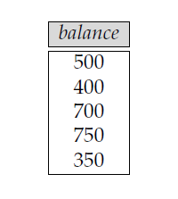
(1) compute first a temporary relation consisting
of those balances that are not the largest
Πaccount .balance (σaccount .balance < d.balance (account × ρd (account)))

Slide 57
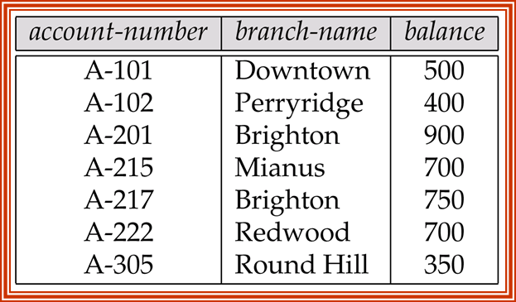
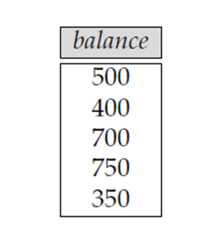
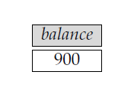
Query:
Find the largest account balance in the bank.
(2) take the set difference between
the relation Πbalance (account) and the temporary relation just computed, to obtain
Πbalance (account) −
Πaccount .balance (σaccount .balance < d.balance (account × ρd (account)))

Slide 58
???
Πaccount .balance (σaccount .balance > d.balance (account × ρd (account)))
Account_no | Brance_name | Balance | Account_no | Brance_name | Balance
101 | Rajshahi | 700 | 101 | Rajshahi | 700
101 | Rajshahi | 700 | 104 | Bogra | 450
101 | Rajshahi | 700 | 112 | Rajshahi | 900
101 | Rajshahi | 700 | 130 | Khulna | 600
101 | Rajshahi | 700 | 140 | Dhaka | 350
104 | Bogra | 450 | 101 | Rajshahi | 700
104 | Bogra | 450 | 104 | Bogra | 450
104 | Bogra | 450 | 112 | Rajshahi | 900
104 | Bogra | 450 | 130 | Khulna | 600
104 | Bogra | 450 | 140 | Dhaka | 350
112 | Rajshahi | 900 | 101 | Rajshahi | 700
112 | Rajshahi | 900 | 104 | Bogra | 450
112 | Rajshahi | 900 | 112 | Rajshahi | 900
112 | Rajshahi | 900 | 130 | Khulna | 600
112 | Rajshahi | 900 | 140 | Dhaka | 350
130 | Khulna | 600 | 101 | Rajshahi | 700
130 | Khulna | 600 | 104 | Bogra | 450
130 | Khulna | 600 | 112 | Rajshahi | 900
130 | Khulna | 600 | 130 | Khulna | 600
130 | Khulna | 600 | 140 | Dhaka | 350
140 | Dhaka | 350 | 101 | Rajshahi | 700
140 | Dhaka | 350 | 104 | Bogra | 450
140 | Dhaka | 350 | 112 | Rajshahi | 900
140 | Dhaka | 350 | 130 | Khulna | 600
140 | Dhaka | 350 | 140 | Dhaka | 350

Slide 59
???
Πaccount .balance (σaccount .balance > d.balance (account × ρd (account)))
ΠT1 .balance
ΠT2 .balance
Account_no | Brance_name | Balance | Account_no | Brance_name | Balance
101 | Rajshahi | 700 | 101 | Rajshahi | 700
101 | Rajshahi | 700 | 104 | Bogra | 450
101 | Rajshahi | 700 | 112 | Rajshahi | 900
101 | Rajshahi | 700 | 130 | Khulna | 600
101 | Rajshahi | 700 | 140 | Dhaka | 350
104 | Bogra | 450 | 101 | Rajshahi | 700
104 | Bogra | 450 | 104 | Bogra | 450
104 | Bogra | 450 | 112 | Rajshahi | 900
104 | Bogra | 450 | 130 | Khulna | 600
104 | Bogra | 450 | 140 | Dhaka | 350
112 | Rajshahi | 900 | 101 | Rajshahi | 700
112 | Rajshahi | 900 | 104 | Bogra | 450
112 | Rajshahi | 900 | 112 | Rajshahi | 900
112 | Rajshahi | 900 | 130 | Khulna | 600
112 | Rajshahi | 900 | 140 | Dhaka | 350
130 | Khulna | 600 | 101 | Rajshahi | 700
130 | Khulna | 600 | 104 | Bogra | 450
130 | Khulna | 600 | 112 | Rajshahi | 900
130 | Khulna | 600 | 130 | Khulna | 600
130 | Khulna | 600 | 140 | Dhaka | 350
140 | Dhaka | 350 | 101 | Rajshahi | 700
140 | Dhaka | 350 | 104 | Bogra | 450
140 | Dhaka | 350 | 112 | Rajshahi | 900
140 | Dhaka | 350 | 130 | Khulna | 600
140 | Dhaka | 350 | 140 | Dhaka | 350

Slide 60
Example Queries
Find the names of all customers who have a loan at the Perryridge branch but do not have an account at any branch of the bank.
∏_{customer_name} (σ_{branch_name = “Perryridge”}
(σborrower.loan_number = loan.loan_number(borrower x loan))) – ∏_{customer_name}(depositor)

Slide 61
Formal Definition
A basic expression in the relational algebra consists of either one of the following:
A relation in the database
A constant relation
Let E₁ and E₂ be relational-algebra expressions; the following are all relational-algebra expressions:
E₁ ∪ E₂
E₁ – E₂
E₁ x E₂
σ_{p} (E₁), P is a predicate on attributes in E₁
∏_{s}(E₁), S is a list consisting of some of the attributes in E₁
ρ _{x} (E₁), x is the new name for the result of E₁

Slide 62
Additional Operations
We define additional operations that do not add any power to the
relational algebra, but that simplify common queries.
Set intersection
Natural join
Division
Assignment

Slide 63
Set-Intersection Operation
Notation: r ∩ s
Defined as:
r ∩ s = { t | t ∈ r and t ∈ s }
Assume:
r, s have the same arity
attributes of r and s are compatible
Note: r ∩ s = r – (r – s)

Slide 64
Set-Intersection Operation – Example
Relation r, s:
r ∩ s
A B
A B
α
α
β
1
2
1
α
β
2
3
r
s
A B
α 2

Slide 65
Query
Find all customers who have both a loan and an account.
The account relation
The depositor Relation
The borrower relation
The customer Relation

Slide 66
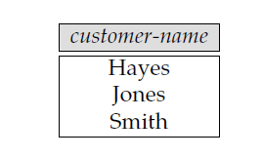
Query
Find all customers who have both a loan and an account.
The borrower relation
The depositor Relation
Πcustomer-name (depositor)
Πcustomer-name (borrower ) ∩
Πcustomer-name (depositor)
Πcustomer-name (borrower )
? = Πcustomer-name (borrower ) −
(Πcustomer-name (borrower) − Πcustomer-name (depositor))

Slide 67
Query
Find all customers who have both a loan and an account.
The borrower relation
The depositor Relation
Πcustomer-name (depositor)
Πcustomer-name (borrower ) ∩
Πcustomer-name (depositor)
Πcustomer-name (borrower )
? = Πcustomer-name (depositor) −
(Πcustomer-name (depositor)− Πcustomer-name (borrower) )

Slide 68
Natural-Join Operation
Notation: r s
Let r and s be relations on schemas R and S respectively. Then, r s is a relation on schema R ∪ S obtained as follows:
Consider each pair of tuples t_{r} from r and t_{s} from s.
If t_{r} and t_{s} have the same value on each of the attributes in R ∩ S, add a tuple t to the result, where
t has the same value as t_{r} on r
t has the same value as t_{s} on s
Example:
R = (A, B, C, D)
S = (E, B, D)
Result schema = (A, B, C, D, E)
r s is defined as: ∏_{r.A, r.B, r.C, r.D, s.E} (σ_{r.B = s.B} ∧ _{r.D = s.D} (r x s))

Slide 69
Natural Join Operation – Example
Relations r, s:
A
B
C
D
B
D
E
`
1
3
1
2
3
a
a
a
b
b
α
β
γ
δ
∈
α
β
γ
α
δ
1
2
4
1
2
α
γ
β
γ
β
`a
a
b
a
b
r
s
r s

Slide 70
Natural Join Operation – Example
Relations r, s:
A
B
C
D
B
D
E
`
1
3
1
2
3
a
a
a
b
b
α
β
γ
δ
∈
α
β
γ
α
δ
1
2
4
1
2
α
γ
β
γ
β
`a
a
b
a
b
r
s
r s

Slide 71
Natural Join Operation – Example
Relations r, s:
A
B
C
D
B
D
E
`
1
3
1
2
3
a
a
a
b
b
α
β
γ
δ
∈
α
β
γ
α
δ
1
2
4
1
2
α
γ
β
γ
β
`a
a
b
a
b
r
s
r s
A
B
C
D
E
α
α
α
α
δ
1
1
1
1
2
α
α
γ
γ
β
a
a
a
a
b
α
γ
α
γ
δ

Slide 72
Query:
Find the names of all customers who have a loan at the bank, along with the loan number and the loan amount
The loan relation

Slide 73

Query:
Find the names of all customers who have a loan at the bank, along with the loan number and the loan amount
Πcustomer-name, loan.loan-number, amount
(σborrower .loan-number =loan.loan-number (borrower × loan))
Cartesian product of its two arguments:
Selection forcing equality on those attributes that appear in both relation schemas,
Finally removes duplicate attributes
R = (A, B, C, D)
S = (E, B, D)
Result schema = (A, B, C, D, E)
r s is defined as: ∏_{r.A, r.B, r.C, r.D, s.E} (σ_{r.B = s.B} ∧ _{r.D = s.D} (r x s))
Let r(R) and s(S) be relations without any attributes in common; that is, R ∩ S = ∅.

Slide 74
https://studysection.com/blog/join-two-tables-without-a-common-column-in-mysql/

Slide 75
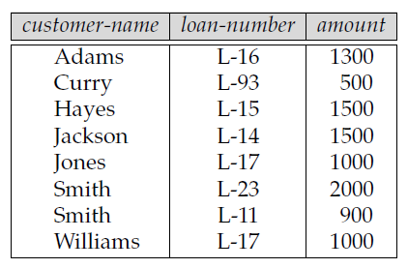
Query:
Find the names of all customers who have a loan at the bank, along with the loan number and the loan amount
Πcustomer-name, loan.loan-number, amount
(σborrower .loan-number =loan.loan-number (borrower × loan))
The loan relation
`

Slide 76
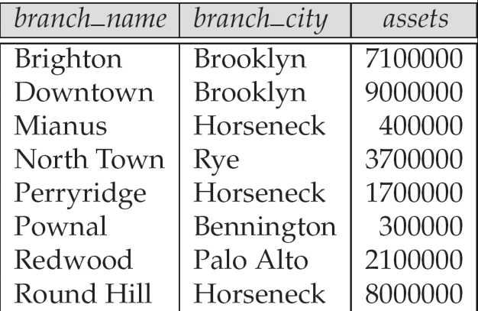
Query:
Find the names of all branches with customers who have an account in the bank and who live in Harrison.
The loan relation
The branch relation
The account relation

Slide 77

Query:
Find the names of all branches with customers who have an account in the bank and who live in Harrison.
The account relation

Slide 78

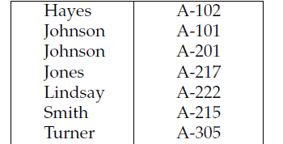
Query:
Find the names of all branches with customers who have an account in the bank and who live in Harrison.
The account relation

Slide 79
Query:
Find the names of all branches with customers who have an account in the bank and who live in Harrison.
The account relation

Slide 80
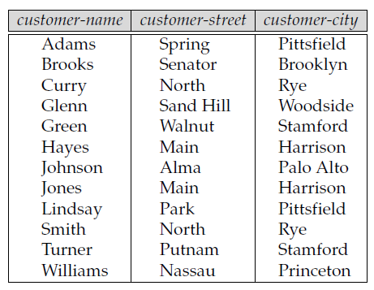
Query:
Find the names of all branches with customers who have an account in the bank and who live in Harrison.
The account relation

Slide 81
Division Operation
r ÷ s
Notation:
Suited to queries that include the phrase “for all”.
Let r and s be relations on schemas R and S respectively where
R = (A₁, …, A_{m} , B₁, …, B_{n} )
S = (B₁, …, B_{n})
The result of r ÷ s is a relation on schema
R – S = (A₁, …, A_{m})
r ÷ s = { t | t ∈ ∏ _{R-S} (r) ∧ ∀ u ∈ s ( tu ∈ r ) }
Where tu means the concatenation of tuples t and u to produce a single tuple

Slide 82
r ÷ s is used when we wish to express queries with “all”
Ex.
“Which persons have a loyal customer's card at ALL the clothing boutiques in town X?”
“Which persons have a bank account at ALL the banks in the country?”
“Which students are registered on ALL the courses given by Soini?”
“Which students are registered on ALL the courses that are taught in period 1?”
“Which boys are registered on those courses that are taken by ALL the girls?”
“Which girls are registered on ALL the courses taken by student nr. 40101?”
“IF there is a clothing boutique in town X THEN the person has a loyal customer's card there”,
“IF Soini gives a course THEN the student is registered on it” or
“IF 40101 is registered on a course THEN the girl is registered on the same course”.

Slide 83
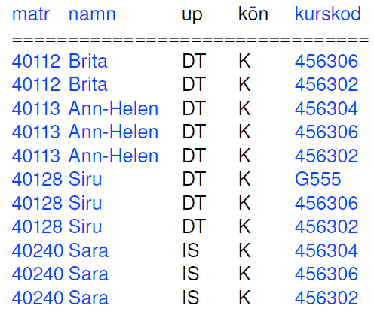
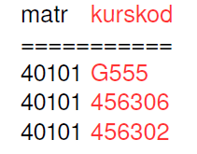
Query:
“Which girls are registered on ALL the courses taken by student nr. 40101?”
Suppose that 40101 takes three courses: G555, 456306 and 456302.
To get e a part of the answer the girl in question
must be registered on ALL of these three.
(In addition to that she may be registered on other courses not taken by 40101, these will not affect the result.)

Slide 84
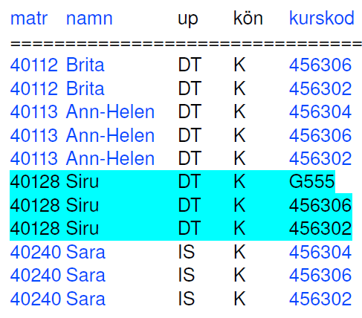
Query:
“Which girls are registered on ALL the courses taken by student nr. 40101?”

Slide 85
Example 3: for X1 of r for all Y1 and Y2 of s ???
r
s
X1 | Y1 | Y2 | X2
A | P | 3 | 1
A | P | 4 | 1
B | Q | 2 | 6
A | P | 3 | 1
C | Z | 1 | 2
A | P | 1 | 1
B | Q | 4 | 1
A | P | 2 | 2
A | Q | 2 | 4
A | P | 5 | 1
Y1 | Y2
P | 1
P | 2
Q | 2

Slide 86
Example 3: for X1 of r for all Y1 and Y2 of s ???
r
s
X1 | Y1 | Y2 | X2
A | P | 3 | 1
A | P | 4 | 1
B | Q | 2 | 6
A | P | 3 | 1
C | Z | 1 | 2
A | P | 1 | 1
B | Q | 4 | 1
A | P | 2 | 2
A | Q | 2 | 4
A | P | 5 | 1
Y1 | Y2
P | 1
P | 2
Q | 2

Slide 87
Example 3: for X1 of r for all Y1 and Y2 of s ???
r
s
X1 | Y1 | Y2
A | P | 3
A | P | 4
B | Q | 2
A | P | 3
C | Z | 1
A | P | 1
B | Q | 4
A | P | 2
A | Q | 2
A | P | 5
Y1 | Y2
P | 1
P | 2
Q | 2

Slide 88
Example 3: for X1 and X2 of r for all Y1 and Y2 of s ???
r
s
X1 | Y1 | Y2 | X2 | X3
A | P | 3 | 1 | ?
A | P | 4 | 1 | ?
B | Q | 2 | 6 | ?
A | P | 3 | 1 | ?
C | Z | 1 | 2 | ?
A | P | 1 | 1 | ?
B | Q | 4 | 1 | ?
A | P | 2 | 2 | ?
A | Q | 2 | 4 | ?
A | P | 5 | 1 | ?
Y1 | Y2
P | 1
P | 2
Q | 2

Slide 89
Which boys name and roll are registered on ALL courses that are taken by the girls?”
B.Name | Roll | Cell | Course ID
X | 201 | 01711 | CSE101
X | 201 | 01711 | CSE 102
X | 202 | 01711 | CSE 103
Y | 202 | 01911 | CSE 102
Y | 202 | 01911 | CSE 101
Z | 203 | 01811 | CSE 104
Z | 203 | 01811 | CSE 101
X | 204 | 01811 | CSE 104
G.Name | Roll | Cell | Course ID
A | 101 | 01711 | CSE101
A | 101 | 01711 | CSE 102
A | 101 | 01711 | CSE 103
B | 102 | 01911 | CSE 102
B | 102 | 01911 | CSE 101
C | 103 | 01811 | CSE 104
C | 103 | 01811 | CSE 101
C | 103 | 01811 | CSE 102

Slide 90
Which boys name and roll are registered on ALL courses that are taken by the girls?”
B.Name | Roll | Cell | Course ID
X | 201 | 01711 | CSE101
X | 201 | 01711 | CSE 102
X | 201 | 01711 | CSE 103
Y | 202 | 01911 | CSE 102
Y | 202 | 01911 | CSE 101
Z | 203 | 01811 | CSE 104
Z | 203 | 01811 | CSE 101
X | 201 | 01811 | CSE 104
G.Name | Roll | Cell | Course ID
A | 101 | 01711 | CSE101
A | 101 | 01711 | CSE 102
A | 101 | 01711 | CSE 103
B | 102 | 01911 | CSE 102
B | 102 | 01911 | CSE 101
C | 103 | 01811 | CSE 104
C | 103 | 01811 | CSE 101
C | 103 | 01811 | CSE 102

Slide 91
Which boys name and roll are registered on ALL courses that are taken by the girls?”
B.Name | Roll | Course ID
X | 201 | CSE101
X | 201 | CSE 102
X | 201 | CSE 103
Y | 202 | CSE 102
Y | 202 | CSE 101
Z | 203 | CSE 104
Z | 203 | CSE 101
X | 201 | CSE 104
Course ID
CSE101
CSE 102
CSE 103
CSE 104

Slide 92
Which boys name and roll are registered on ALL courses that are taken by the girls?”
B.Name | Roll | Course ID
X | 201 | CSE101
X | 201 | CSE 102
X | 201 | CSE 103
Y | 202 | CSE 102
Y | 202 | CSE 101
Z | 203 | CSE 104
Z | 203 | CSE 101
X | 201 | CSE 104
Course ID
CSE101
CSE 102
CSE 103
CSE 104

Slide 93
Which boys name and roll are registered on those courses that are taken by ALL the girls?”
B.Name | Roll | Cell | Course ID
X | 201 | 01711 | CSE101
X | 201 | 01711 | CSE 102
Y | 202 | 01711 | CSE 103
Y | 202 | 01911 | CSE 102
Y | 202 | 01911 | CSE 101
Z | 203 | 01811 | CSE 104
Z | 203 | 01811 | CSE 101
W | 204 | 01811 | CSE 102
G.Name | Roll | Cell | Course ID
A | 101 | 01711 | CSE101
A | 101 | 01711 | CSE 102
A | 101 | 01711 | CSE 103
B | 102 | 01911 | CSE 102
B | 102 | 01911 | CSE 101
C | 103 | 01811 | CSE 104
C | 103 | 01811 | CSE 101
C | 103 | 01811 | CSE 102

Slide 94
Which boys name and roll are registered on those courses that are taken by ALL the girls?”
B.Name | Roll | Cell | Course ID
X | 201 | 01711 | CSE101
X | 201 | 01711 | CSE 102
Y | 202 | 01711 | CSE 103
Y | 202 | 01911 | CSE 102
Y | 202 | 01911 | CSE 101
Z | 203 | 01811 | CSE 104
Z | 203 | 01811 | CSE 101
W | 204 | 01811 | CSE 102
G.Name | Roll | Cell | Course ID
A | 101 | 01711 | CSE101
A | 101 | 01711 | CSE 102
A | 101 | 01711 | CSE 103
B | 102 | 01911 | CSE 102
B | 102 | 01911 | CSE 101
C | 103 | 01811 | CSE 104
C | 103 | 01811 | CSE 101
C | 103 | 01811 | CSE 102

Slide 95
Which boys name and roll are registered on those courses that are taken by ALL the girls?”
B.Name | Roll | Cell | Course ID
X | 201 | 01711 | CSE101
X | 201 | 01711 | CSE 102
Y | 202 | 01711 | CSE 103
Y | 202 | 01911 | CSE 102
Y | 202 | 01911 | CSE 101
Z | 203 | 01811 | CSE 104
Z | 203 | 01811 | CSE 101
W | 204 | 01811 | CSE 102
G.Name | Roll | Cell | Course ID
A | 101 | 01711 | CSE101
A | 101 | 01711 | CSE 102
A | 101 | 01711 | CSE 103
B | 102 | 01911 | CSE 102
B | 102 | 01911 | CSE 101
C | 103 | 01811 | CSE 104
C | 103 | 01811 | CSE 101
C | 103 | 01811 | CSE 102

Slide 96
Which boys name and roll are registered on those courses that are taken by ALL the girls?”
G.Name/Roll??? Primary key
B.Name | Roll | Course ID
X | 201 | CSE101
X | 201 | CSE 102
Y | 202 | CSE 103
Y | 202 | CSE 102
Y | 202 | CSE 101
Z | 203 | CSE 104
Z | 203 | CSE 101
W | 204 | CSE 102
G.Name | Course ID
A | CSE101
A | CSE 102
A | CSE 103
B | CSE 102
B | CSE 101
C | CSE 104
C | CSE 101
C | CSE 102

Slide 97
Which boys name and roll are registered on those courses that are taken by ALL the girls?”
G.Name/Roll??? Primary key
B.Name | Roll | Course ID
X | 201 | CSE101
X | 201 | CSE 102
Y | 202 | CSE 103
Y | 202 | CSE 102
Y | 202 | CSE 101
Z | 203 | CSE 104
Z | 203 | CSE 101
W | 204 | CSE 102
G.Name | Course ID
A | CSE101
A | CSE 102
A | CSE 103
B | CSE 102
B | CSE 101
C | CSE 104
C | CSE 101
C | CSE 102
G.Name | Course ID
A | CSE101
A | CSE 102
A | CSE 103
B | CSE 102
B | CSE 101
C | CSE 104
C | CSE 101
C | CSE 102

Slide 98
Which boys name and roll are registered on those courses that are taken by ALL the girls?”
B.Name | Roll | Course ID
X | 201 | CSE101
X | 201 | CSE 102
Y | 202 | CSE 103
Y | 202 | CSE 102
Y | 202 | CSE 101
Z | 203 | CSE 104
Z | 203 | CSE 101
W | 204 | CSE 102
G.Name | Course ID
A | CSE101
A | CSE 102
A | CSE 103
B | CSE 102
B | CSE 101
C | CSE 104
C | CSE 101
C | CSE 102
Course ID | G.Name
CSE101 | A
CSE101 | B
CSE101 | C
CSE 102 | A
CSE 102 | B
CSE 102 | C
CSE 103 | A
CSE 104 | C

Slide 99
Which boys name and roll are registered on those courses that are taken by ALL the girls?”
B.Name | Roll | Course ID
X | 201 | CSE101
X | 201 | CSE 102
Y | 202 | CSE 103
Y | 202 | CSE 102
Y | 202 | CSE 101
Z | 203 | CSE 104
Z | 203 | CSE 101
W | 204 | CSE 102
Course ID | G.Name
CSE101 | A
CSE101 | B
CSE101 | C
CSE 102 | A
CSE 102 | B
CSE 102 | C
CSE 103 | A
CSE 104 | C
G.Name
A
B
C

Slide 100
Which boys name and roll are registered on those courses that are taken by ALL the girls?”
B.Name | Roll | Course ID
X | 201 | CSE101
X | 201 | CSE 102
Y | 202 | CSE 103
Y | 202 | CSE 102
Y | 202 | CSE 101
Z | 203 | CSE 104
Z | 203 | CSE 101
W | 204 | CSE 102
Course ID
CSE101
CSE 102

Slide 101
Which boys name and roll are registered on those courses that are taken by ALL the girls?”
G.Name/Roll??? Primary key
B.Name | Roll | Course ID
X | 201 | CSE101
X | 201 | CSE 102
Y | 202 | CSE 103
Y | 202 | CSE 102
Y | 202 | CSE 101
Z | 203 | CSE 104
Z | 203 | CSE 101
W | 204 | CSE 102
Course ID
CSE101
CSE 102

Slide 102
Which boys name and roll are registered on those courses that are taken by ALL the girls?”
B.Name | Roll | Course ID
X | 201 | CSE101
X | 201 | CSE 102
Y | 202 | CSE 103
Y | 202 | CSE 102
Y | 202 | CSE 101
Z | 203 | CSE 104
Z | 203 | CSE 101
W | 204 | CSE 102
B.Name | Roll
X | 201
Y | 202

Slide 103
Division Operation
Query 1
All customers who have an account at all the branches located in Brooklyn.
The loan relation
The branch relation
The account relation

Slide 104
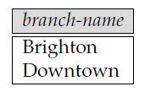
Division Operation
Query 1
All customers who have an account at all the branches located in Brooklyn.
The branch relation
Step 1:
obtain all branches in Brooklyn
r1 = Πbranch-name (σbranch-city =“Brooklyn” (branch))

Slide 105
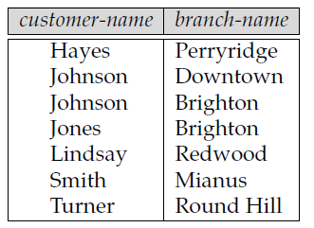
Division Operation
Query 1
All customers who have an account at all the branches located in Brooklyn.
Step 2:
find all (customer-name, branch-name) pairs
for which the customer has an
account at a branch
The depositor Relation
The account relation

Slide 106

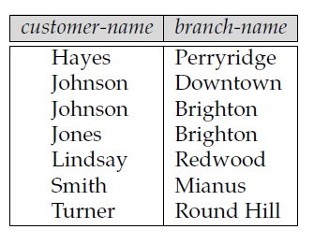
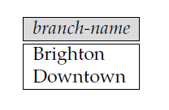
Division Operation
To find customers who appear in r2 with every branch name in r1.
The operation that provides exactly those customers is the divide operation.
We formulate the query by writing
Step 3:
To find customers who appear in r2 with every branch name in r1.
The operation that provides exactly those customers is the divide operation.

Slide 107
Division Operation
let r(R) and s(S) be relations,
let S ⊆ R;
(that is, every attribute of schema S is also in schema R)
The relation r ÷ s is a relation on schema R − S
(that is, on the schema containing all attributes of schema R that are not in schema S).
A tuple t is in r ÷ s if and only if both of two conditions hold:
1. t is in Π_{R−S}(r)
2. For every tuple ts in s, there is a tuple tr in r satisfying both of the following:
a. tr[S] = ts[S]
b. tr[R − S] = t
tr[ Course ID] = ts[Course ID]
b. tr[B.Name, Roll] = t
B.Name | Roll | Course ID
X | 201 | CSE101
X | 201 | CSE 102
X | 201 | CSE 103
Y | 202 | CSE 102
Y | 202 | CSE 101
Z | 203 | CSE 104
Z | 203 | CSE 101
X | 201 | CSE 104
Course ID
CSE101
CSE 102
CSE 103
CSE 104

Slide 108

Let r(R) and s(S) be given, with S ⊆ R:
r ÷ s = ΠR−S (r) − ΠR−S ((ΠR−S (r) × s) − ΠR−S,S(r))
A tuple t is in r ÷ s if and only if both of two conditions hold:
1. t is in ΠR−S(r)
2. For every tuple ts in s, there is a tuple tr in r satisfying both of the following:
a. tr[S] = ts[S]
b. tr[R − S] = t

Slide 109
ΠR−S ((ΠR−S (r) × s) − ΠR−S,S(r))
ΠR−S,S(r) merely reorders the attributes of r.`
ΠR−S (r) × s. This relation is on schema R
Pairs every tuple in ΠR−S (r) with every tuple in s.
(ΠR−S (r) × s) − ΠR−S,S(r) (gives us those pairs of tuples
from ΠR−S (r) and s that do not appear in r.
ΠR−S ((ΠR−S (r) × s) − ΠR−S,S(r)) If a tuple tj is in here;
Then there is some tuple ts in s that does not
combine with tuple tj to form a tuple in r.
Thus, t_{j} holds a value for attributes R − S that does not appear in r ÷ s. It is these values that we eliminate from ΠR−S (r).

Slide 110
Division Operation – Example
Relations r, s:
A
B
B
α
α
α
β
γ
δ
δ
δ
∈
∈
β
1
2
3
1
1
1
3
4
6
1
2
1
2
s
r ÷ s:
A
r
α
β

Slide 111
Another Division Example
Relations r, s:
A
B
C
D
E
D
E
α
α
α
β
β
γ
γ
γ
a
a
a
a
a
a
a
a
α
γ
γ
γ
γ
γ
γ
β
a
a
b
a
b
a
b
b
1
1
1
1
3
1
1
1
a
b
1
1
s
r ÷ s:
r
A
B
C
α
γ
a
a
γ
γ

Slide 112
Example 1: for X1 and X2 of r for all Y1 and Y2 of s
r
s
X1 | Y1 | Y2 | X2
A | P | 3 | 1
B | Q | 2 | 1
A | P | 3 | 1
C | P | 1 | 2
A | P | 1 | 1
B | Q | 2 | 1
A | P | 2 | 1
C | P | 2 | 2
A | Q | 2 | 1
Y1 | Y2
P | 1
P | 2
Q | 2

Slide 113
Example 1
r
X1 | Y1 | Y2 | X2
A | P | 3 | 1
B | Q | 2 | 1
A | P | 3 | 1
C | P | 1 | 2
A | P | 1 | 1
B | Q | 2 | 1
A | P | 2 | 1
C | P | 2 | 2
A | Q | 2 | 1
R
X1 | Y1 | Y2 | X2
S
Y1 | Y2
R-S
X1 | X2
ΠR−S,S(r)
=
ΠX1,X2,Y1,Y2(r)
ΠR−S,S(r)
ΠR−S,S(r) merely reorders the attributes of r.`

Slide 114
Example 1
r
ΠR−S,S(r) = ΠX1,X2,Y1,Y2(r)
X1 | Y1 | Y2 | X2
A | P | 3 | 1
B | Q | 2 | 1
A | P | 3 | 1
C | P | 1 | 2
A | P | 1 | 1
B | Q | 2 | 1
A | P | 2 | 1
C | P | 2 | 2
A | Q | 2 | 1
X1 | X2 | Y1 | Y2
A | 1 | P | 3
B | 1 | Q | 2
A | 1 | P | 3
C | 2 | P | 1
A | 1 | P | 1
B | 1 | Q | 2
A | 1 | P | 2
C | 2 | P | 2
A | 1 | Q | 2
ΠR−S,S(r) merely reorders the attributes of r.`

Slide 115

Example 1
ΠR−S (r) = ΠX1,X2 (r)
X1 | X2
A | 1
B | 1
A | 1
C | 2
A | 1
B | 1
A | 1
C | 2
A | 1
X1 | X2
A | 1
B | 1
C | 2
Y1 | Y2
P | 1
P | 2
Q | 2

Slide 116
Example 1
ΠR−S (r) × s
ΠR−S (r) = ΠX1,X2 (r)
X1 | X2 | Y1 | Y2
A | 1 | P | 1
A | 1 | P | 2
A | 1 | Q | 2
B | 1 | P | 1
B | 1 | P | 2
B | 1 | Q | 2
C | 2 | P | 1
C | 2 | P | 2
C | 2 | Q | 2
X1 | X2
A | 1
B | 1
C | 2
Y1 | Y2
P | 1
P | 2
Q | 2
ΠR−S (r) × s. This relation is on schema R
Pairs every tuple in ΠR−S (r) with every tuple in s.

Slide 117
Example 1
ΠR−S (r) × s
ΠR−S,S(r) = ΠX1,X2,Y1,Y2(r)
X1 | X2 | Y1 | Y2
A | 1 | P | 1
A | 1 | P | 2
A | 1 | Q | 2
B | 1 | P | 1
B | 1 | P | 2
B | 1 | Q | 2
C | 2 | P | 1
C | 2 | P | 2
C | 2 | Q | 2
X1 | X2 | Y1 | Y2
A | 1 | P | 3
B | 1 | Q | 2
A | 1 | P | 3
C | 2 | P | 1
A | 1 | P | 1
B | 1 | Q | 2
A | 1 | P | 2
C | 2 | P | 2
A | 1 | Q | 2
ΠR−S((ΠR−S (r) × s) − ΠR−S,S(r))
X1 | X2
B | 1
C | 2
(ΠR−S (r) × s) − ΠR−S,S(r) (gives us those pairs of tuples from ΠR−S (r) and s that do not appear in r.
ΠR−S ((ΠR−S (r) × s) − ΠR−S,S(r)) If a tuple tj is in here; hen there is some tuple ts in s that does not combine with tuple tj to form a tuple in r.

Slide 118
Example 1
ΠR−S (r) × s
ΠR−S,S(r) = ΠX1,X2,Y1,Y2(r)
X1 | X2 | Y1 | Y2
A | 1 | P | 1
A | 1 | P | 2
A | 1 | Q | 2
B | 1 | P | 1
B | 1 | P | 2
B | 1 | Q | 2
C | 2 | P | 1
C | 2 | P | 2
C | 2 | Q | 2
X1 | X2 | Y1 | Y2
A | 1 | P | 3
B | 1 | Q | 2
A | 1 | P | 3
C | 2 | P | 1
A | 1 | P | 1
B | 1 | Q | 2
A | 1 | P | 2
C | 2 | P | 2
A | 1 | Q | 2
ΠR−S((ΠR−S (r) × s) − ΠR−S,S(r))
X1 | X2
B | 1
C | 2
(ΠR−S (r) × s) − ΠR−S,S(r) (gives us those pairs of tuples from ΠR−S (r) and s that do not appear in r.
ΠR−S ((ΠR−S (r) × s) − ΠR−S,S(r)) If a tuple tj is in here; hen there is some tuple ts in s that does not combine with tuple tj to form a tuple in r.

Slide 119
Example 1
ΠR−S (r) × s
ΠR−S,S(r) = ΠX1,X2,Y1,Y2(r)
X1 | X2 | Y1 | Y2
A | 1 | P | 1
A | 1 | P | 2
A | 1 | Q | 2
B | 1 | P | 1
B | 1 | P | 2
B | 1 | Q | 2
C | 2 | P | 1
C | 2 | P | 2
C | 2 | Q | 2
X1 | X2 | Y1 | Y2
A | 1 | P | 3
B | 1 | Q | 2
A | 1 | P | 3
C | 2 | P | 1
A | 1 | P | 1
B | 1 | Q | 2
A | 1 | P | 2
C | 2 | P | 2
A | 1 | Q | 2
ΠR−S((ΠR−S (r) × s) − ΠR−S,S(r))
X1 | X2
B | 1
C | 2
(ΠR−S (r) × s) − ΠR−S,S(r) (gives us those pairs of tuples from ΠR−S (r) and s that do not appear in r.
ΠR−S ((ΠR−S (r) × s) − ΠR−S,S(r)) If a tuple tj is in here; hen there is some tuple ts in s that does not combine with tuple tj to form a tuple in r.

Slide 120
Example 1
ΠR−S (r) = ΠX1,X2 (r)
ΠR−S((ΠR−S (r) × s) − ΠR−S,S(r))
X1 | X2
A | 1
B | 1
C | 2
X1 | X2
B | 1
C | 2
r ÷ s = ΠR−S (r) − ΠR−S ((ΠR−S (r) × s) − ΠR−S,S(r))
X1 | X2
A | 1

Slide 121
Example 1
r
s
X1 | Y1 | Y2 | X2
A | P | 3 | 1
B | Q | 2 | 1
A | P | 3 | 1
C | P | 1 | 2
A | P | 1 | 1
B | Q | 2 | 1
A | P | 2 | 1
C | P | 2 | 2
A | Q | 2 | 1
Y1 | Y2
P | 1
P | 2
Q | 2

Slide 122
Example 2: for X1 and X2 of r for all Y1 and Y2 of s
r
s
X1 | Y1 | Y2 | X2
A | P | 3 | 1
A | P | 4 | 1
B | Q | 2 | 6
A | P | 3 | 1
C | Z | 1 | 2
A | P | 1 | 1
B | Q | 4 | 1
A | P | 2 | 2
A | Q | 2 | 4
A | P | 5 | 1
Y1 | Y2
P | 1
P | 2
Q | 2

Slide 123
Example 2
r
X1 | Y1 | Y2 | X2
A | P | 3 | 1
A | P | 4 | 1
B | Q | 2 | 6
A | P | 3 | 1
C | Z | 1 | 2
A | P | 1 | 1
B | Q | 4 | 1
A | P | 2 | 2
A | Q | 2 | 4
A | P | 5 | 1
R
X1 | Y1 | Y2 | X2
S
Y1 | Y2
R-S
X1 | X2
ΠR−S,S(r)
=
ΠX1,X2,Y1,Y2(r)
ΠR−S,S(r)

Slide 124
Example 2
r
ΠR−S,S(r) = ΠX1,X2,Y1,Y2(r)
X1 | Y1 | Y2 | X2
A | P | 3 | 1
A | P | 4 | 1
B | Q | 2 | 6
A | P | 3 | 1
C | Z | 1 | 2
A | P | 1 | 1
B | Q | 4 | 1
A | P | 2 | 2
A | Q | 2 | 4
A | P | 5 | 1
X1 | X2 | Y1 | Y2
A | 1 | P | 3
A | 1 | P | 4
B | 6 | Q | 2
A | 1 | P | 3
C | 2 | Z | 1
A | 1 | P | 1
B | 1 | Q | 4
A | 2 | P | 2
A | 4 | Q | 2
A | 1 | P | 5
??? ΠR−S (r) = ΠX1,X2 (r)

Slide 125
Example 2
ΠR−S (r) = ΠX1,X2 (r)
X1 | X2
A | 1
A | 1
B | 6
A | 1
C | 2
A | 1
B | 1
A | 2
A | 4
A | 1
X1 | X2
A | 1
A | 2
A | 4
B | 1
B | 6
C | 2
Y1 | Y2
P | 1
P | 2
Q | 2
??? ΠR−S (r) × s

Slide 126
Example 2
X1 | X2 | Y1 | Y2
A | 1 | P | 1
A | 1 | P | 2
A | 1 | Q | 2
A | 2 | P | 1
A | 2 | P | 2
A | 2 | Q | 2
A | 4 | P | 1
A | 4 | P | 2
A | 4 | Q | 2
B | 1 | P | 1
B | 1 | P | 2
B | 1 | Q | 2
B | 6 | P | 1
B | 6 | P | 2
B | 6 | Q | 2
C | 2 | P | 1
C | 2 | P | 2
C | 2 | Q | 2
ΠR−S (r) = ΠX1,X2 (r)
X1 | X2
A | 1
A | 2
A | 4
B | 1
B | 6
C | 2
Y1 | Y2
P | 1
P | 2
Q | 2
ΠR−S (r) × s
??? ΠR−S((ΠR−S (r) × s) − ΠR−S,S(r))

Slide 127
ΠR−S,S(r) = ΠX1,X2,Y1,Y2(r)
X1 | X2 | Y1 | Y2
A | 1 | P | 1
A | 1 | P | 2
A | 1 | Q | 2
A | 2 | P | 1
A | 2 | P | 2
A | 2 | Q | 2
A | 4 | P | 1
A | 4 | P | 2
A | 4 | Q | 2
B | 1 | P | 1
B | 1 | P | 2
B | 1 | Q | 2
B | 6 | P | 1
B | 6 | P | 2
B | 6 | Q | 2
C | 2 | P | 1
C | 2 | P | 2
C | 2 | Q | 2
ΠR−S (r) × s
X1 | X2 | Y1 | Y2
A | 1 | P | 3
A | 1 | P | 4
B | 6 | Q | 2
A | 1 | P | 3
C | 2 | Z | 1
A | 1 | P | 1
B | 1 | Q | 4
A | 2 | P | 2
A | 4 | Q | 2
A | 1 | P | 5

Slide 128
ΠR−S,S(r) = ΠX1,X2,Y1,Y2(r)
X1 | X2 | Y1 | Y2
A | 1 | P | 1
A | 1 | P | 2
A | 1 | Q | 2
A | 2 | P | 1
A | 2 | P | 2
A | 2 | Q | 2
A | 4 | P | 1
A | 4 | P | 2
A | 4 | Q | 2
B | 1 | P | 1
B | 1 | P | 2
B | 1 | Q | 2
B | 6 | P | 1
B | 6 | P | 2
B | 6 | Q | 2
C | 2 | P | 1
C | 2 | P | 2
C | 2 | Q | 2
ΠR−S (r) × s
X1 | X2 | Y1 | Y2
A | 1 | P | 3
A | 1 | P | 4
B | 6 | Q | 2
A | 1 | P | 3
C | 2 | Z | 1
A | 1 | P | 1
B | 1 | Q | 4
A | 2 | P | 2
A | 4 | Q | 2
A | 1 | P | 5
X1 | X2
A | 1
A | 2
A | 4
B | 1
B | 6
C | 2
ΠR−S((ΠR−S (r) × s) − ΠR−S,S(r))

Slide 129
Example 2
ΠR−S (r) = ΠX1,X2 (r)
ΠR−S((ΠR−S (r) × s) − ΠR−S,S(r))
X1 | X2
A | 1
A | 2
A | 4
B | 1
B | 6
C | 2
X1 | X2
A | 1
A | 2
A | 4
B | 1
B | 6
C | 2
r ÷ s = ΠR−S (r) − ΠR−S ((ΠR−S (r) × s) − ΠR−S,S(r))
X1 | X2

Slide 130
Example 2
r
s
X1 | Y1 | Y2 | X2
A | P | 3 | 1
A | P | 4 | 1
B | Q | 2 | 6
A | P | 3 | 1
C | Z | 1 | 2
A | P | 1 | 1
B | Q | 4 | 1
A | P | 2 | 2
A | Q | 2 | 4
A | P | 5 | 1
Y1 | Y2
P | 1
P | 2
Q | 2

Slide 131
r ÷ s is used
when we wish to express
queries with “all”
Ex.
“Which persons have a loyal customer's card at ALL the clothing boutiques in town X?”
“Which persons have a bank account at ALL the banks in the country?”
“Which students are registered on ALL the courses given by Soini?”
“Which students are registered on ALL the courses that are taught in period 1?”
“Which boys are registered on those courses that are taken by ALL the girls?”
“Which girls are registered on ALL the courses taken by student nr. 40101?”

Slide 132
Assignment Operation
The assignment operation (←) provides a convenient way to express complex queries.
Write query as a sequential program consisting of
a series of assignments
followed by an expression whose value is displayed as a result of the query.
Assignment must always be made to a temporary relation variable.
Example: Write r ÷ s as
temp1 ← ∏_{R-S} (r ) temp2 ← ∏_{R-S} ((temp1 x s ) – ∏_{R-S,S} (r )) result = temp1 – temp2
The result to the right of the ← is assigned to the relation variable on the left of the ←.
May use variable in subsequent expressions.

Slide 133
Bank Example Queries
Find the names of all customers who have a loan and an account at bank.
∏_{customer_name} (borrower) ∩ ∏_{customer_name} (depositor)
Find the name of all customers who have a loan at the bank and the loan amount
∏customer_name, loan_number, amount (borrower loan)

Slide 134
Bank Example Queries
Find all customers who have an account from at least the “Downtown” and the Uptown” branches.
Query 1
∏_{customer_name} (σ_{branch_name = “Downtown”} (depositor account )) ∩
∏_{customer_name} (σ_{branch_name = “Uptown”} (depositor account))
Query 2
∏_{customer_name, branch_name} (depositor account) ÷ ρ_{temp(branch_name)} ({(“Downtown” ), (“Uptown” )})
Note that Query 2 uses a constant relation.

Slide 135
Bank Example Queries
Find all customers who have an account at all branches located in Brooklyn city.
∏_{customer_name, branch_name} (depositor account) ÷ ∏_{branch_name} (σ_{branch_city = “Brooklyn”} (branch))

Slide 136
Extended Relational-Algebra-Operations
Generalized Projection
Aggregate Functions
Outer Join

Slide 137
Generalized Projection
Extends the projection operation by allowing arithmetic functions to be used in the projection list.
E is any relational-algebra expression
Each of F₁, F₂, …, F_{n} are are arithmetic expressions involving constants and attributes in the schema of E.
Given relation credit_info(customer_name, limit, credit_balance), find how much more each person can spend:
∏customer_name, limit – credit_balance (credit_info)

Slide 138
Aggregate Functions and Operations
Aggregation function takes a collection of values and returns a single value as a result.
avg: average value min: minimum value max: maximum value sum: sum of values count: number of values
Aggregate operation in relational algebra
E is any relational-algebra expression
G₁, G₂ …, G_{n} is a list of attributes on which to group (can be empty)
Each F_{i} is an aggregate function
Each A_{i} is an attribute name

Slide 139
Aggregate Operation – Example
Relation r:
A
B
C
α
α
β
β
α
β
β
β
7
7
3
10
g _{sum(c)} (r)
sum(c )
27

Slide 140
Aggregate Operation – Example
Relation account grouped by branch-name:
branch_name
account_number
balance
Perryridge
Perryridge
Brighton
Brighton
Redwood
A-102
A-201
A-217
A-215
A-222
400
900
750
750
700
_{branch_name} g _{sum(balance)} (account)
branch_name
sum(balance)
Perryridge
Brighton
Redwood
1300
1500
700

Slide 141
Aggregate Functions (Cont.)
Result of aggregation does not have a name
Can use rename operation to give it a name
For convenience, we permit renaming as part of aggregate operation
_{branch_name} g _{sum(balance) as sum_balance} (account)

Slide 142
Outer Join
An extension of the join operation that avoids loss of information.
Computes the join and then adds tuples form one relation that does not match tuples in the other relation to the result of the join.
Uses null values:
null signifies that the value is unknown or does not exist
All comparisons involving null are (roughly speaking) false by definition.
We shall study precise meaning of comparisons with nulls later

Slide 143
Outer Join – Example
Relation loan
loan_number
branch_name
amount
L-170
L-230
L-260
Downtown
Redwood
Perryridge
3000
4000
1700
Relation borrower
customer_name
loan_number
Jones
Smith
Hayes
L-170
L-230
L-155

Slide 144
Outer Join – Example
Join loan borrower
loan_number
branch_name
amount
customer_name
L-170
L-230
Downtown
Redwood
3000
4000
Jones
Smith
Left Outer Join
loan borrower
loan_number
branch_name
amount
customer_name
L-170
L-230
L-260
Downtown
Redwood
Perryridge
3000
4000
1700
Jones
Smith
null

Slide 145
Outer Join – Example
Right Outer Join
loan borrower
loan_number
branch_name
amount
customer_name
L-170
L-230
L-155
Downtown
Redwood
null
3000
4000
null
Jones
Smith
Hayes
Full Outer Join
loan borrower
loan_number
branch_name
amount
customer_name
L-170
L-230
L-260
L-155
Downtown
Redwood
Perryridge
null
3000
4000
1700
null
Jones
Smith
null
Hayes

Slide 146
Null Values
It is possible for tuples to have a null value, denoted by null, for some of their attributes
null signifies an unknown value or that a value does not exist.
The result of any arithmetic expression involving null is null.
Aggregate functions simply ignore null values (as in SQL)
For duplicate elimination and grouping, null is treated like any other value, and two nulls are assumed to be the same (as in SQL)

Slide 147
Null Values
Comparisons with null values return the special truth value: unknown
Three-valued logic using the truth value unknown:
OR: (unknown or true) = true, (unknown or false) = unknown (unknown or unknown) = unknown
AND: (true and unknown) = unknown, (false and unknown) = false, (unknown and unknown) = unknown
NOT: (not unknown) = unknown
In SQL “P is unknown” evaluates to true if predicate P evaluates to unknown
Result of select predicate is treated as false if it evaluates to unknown

Slide 148
Modification of the Database
The content of the database may be modified using the following operations:
Deletion
Insertion
Updating
All these operations are expressed using the assignment operator.

Slide 149
Deletion
A delete request is expressed similarly to a query, except instead of displaying tuples to the user, the selected tuples are removed from the database.
Can delete only whole tuples; cannot delete values on only particular attributes
A deletion is expressed in relational algebra by:
r ← r – E
where r is a relation and E is a relational algebra query.

Slide 150
Deletion Examples
Delete all account records in the Perryridge branch.
account ← account – σ _{branch_name = “Perryridge”} (account )
Delete all loan records with amount in the range of 0 to 50
loan ← loan – σ _{amount ≥ 0 and amount ≤ 50} (loan)

Slide 151
Insertion
To insert data into a relation, we either:
specify a tuple to be inserted
write a query whose result is a set of tuples to be inserted
in relational algebra, an insertion is expressed by:
r ← r ∪ E
where r is a relation and E is a relational algebra expression.
The insertion of a single tuple is expressed by letting E be a constant relation containing one tuple.

Slide 152
Insertion Examples
Insert information in the database specifying that Smith has $1200 in account A-973 at the Perryridge branch.
account ← account ∪ {(“A-973”, “Perryridge”, 1200)}
depositor ← depositor ∪ {(“Smith”, “A-973”)}

Slide 153
Updating
A mechanism to change a value in a tuple without charging all values in the tuple
Use the generalized projection operator to do this task
Each F_{i} is either
the I ^{th} attribute of r, if the I ^{th} attribute is not updated, or,
if the attribute is to be updated F_{i} is an expression, involving only constants and the attributes of r, which gives the new value for the attribute

Slide 154
Update Examples
Make interest payments by increasing all balances by 5 percent.
account ← ∏ account_number, branch_name, balance * 1.05 (account)

Slide 155
Tuple Relational Calculus (TRC) in DBMS
Tuple Relational Calculus is a non-procedural query language unlike relational algebra.
Tuple Calculus provides only the description of the query but it does not provide the methods to solve it.
Thus, it explains what to do but not how to do.
Source: https://www.geeksforgeeks.org/

Slide 156
Tuple Calculus
A query is expressed as
{t| P(t)} , Where
t = resulting tuples, P(t) = known as Predicate
These are the conditions that are used to fetch t
Thus, it generates set of all tuples t
such that Predicate P(t) is true for t.
P(t) may have various conditions logically combined with
OR (∨), AND (∧), NOT(¬).`

Slide 157
Table-1: Customer
Customer name | Street | City
Saurabh | A7 | Patiala
Mehak | B6 | Jalandhar
Sumiti | D9 | Ludhiana
Ria | A5 | Patiala
Table-2: Branch
Branch name | Branch city
ABC | Patiala
DEF | Ludhiana
GHI | Jalandhar

Slide 158
Table-3: Account
Account number | Branch name | Balance
1111 | ABC | 50000
1112 | DEF | 10000
1113 | GHI | 9000
1114 | ABC | 7000
Table-4: Loan
Loan number | Branch name | Amount
L33 | ABC | 10000
L35 | DEF | 15000
L49 | GHI | 9000
L98 | DEF | 65000

Slide 159
Table-5: Borrower
Customer name | Loan number
Saurabh | L33
Mehak | L49
Ria | L98
Table-6: Depositor
Customer name | Account number
Saurabh | 1111
Mehak | 1113
Sumiti | 1114

Slide 160
Queries-1
: Find the loan number, branch, amount of loans of greater than or equal to 10000 amount.
{t| t ∈ loan ∧ t[amount]>=10000}
Loan number | Branch name | Amount
L33 | ABC | 10000
L35 | DEF | 15000
L98 | DEF | 65000

Slide 161
Queries-2
Find the loan number for each loan of an amount greater or equal to 10000.
{t| ∃ s ∈ loan(t[loan number] = s[loan number] ∧ s[amount]>=10000)}
Loan number
L33
L35
L98

Slide 162
Queries-3
Find the names of all customers who have a loan and an account at the bank.
{t | ∃ s ∈ borrower( t[customer-name] = s[customer-name]) ∧ ∃ u ∈ depositor( t[customer-name] = u[customer-name])
Customer name
Saurabh
Mehak

Slide 163
Queries-4
Find the names of all customers having a loan at the “ABC” branch.
{t | ∃ s ∈ borrower(t[customer-name] = s[customer-name] ∧ ∃ u ∈ loan(u[branch-name] = “ABC” ∧ u[loan-number] = s[loan-number]))}
Customer name
Saurabh

Slide 164
Domain Relational Calculus in DBMS
Domain Relational Calculus is a non-procedural query language equivalent in power to Tuple Relational Calculus.
Domain Relational Calculus provides only the description of the query but it does not provide the methods to solve it. In Domain Relational Calculus, a query is expressed as,

Slide 165
Query-1:
Find the loan number, branch, amount of loans of greater than or equal to 100 amount.
{≺l, b, a≻ | ≺l, b, a≻ ∈ loan ∧ (a ≥ 100)}
Loan number | Branch name | Amount
L01 | Main | 200
L03 | Main | 150

Slide 166
Query-2:
Find the loan number for each loan of an amount greater or equal to 150.
{≺l≻ | ∃ b, a (≺l, b, a≻ ∈ loan ∧ (a ≥ 150)}
Loan number
L01
L03

Slide 167
Query-3
Find the names of all customers having a loan at the “Main” branch and find the loan amount .
{≺c, a≻ | ∃ l (≺c, l≻ ∈ borrower ∧ ∃ b (≺l, b, a≻ ∈ loan ∧ (b = “Main”)))
Customer Name | Amount
Ritu | 200
Debomit | 60
Soumya | 150

Slide 168
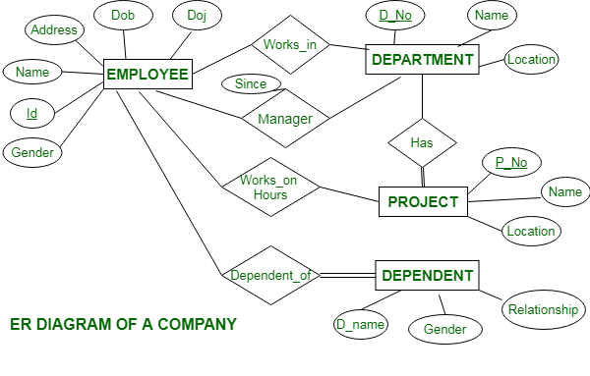

Slide 169
